Slide 1
Definitions
Sample. A subset of a population.
Population. The collection of all outcomes, responses, and measurements.
Statistic. A numerical description of a sample characteristic.
Parameter. A numerical description of a population characteristic.

Slide 2
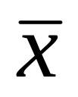
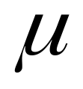

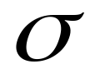
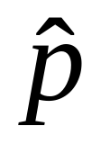

Sample
Population
Statistics
Point Estimates
Parameters
The True Value
mu
Mean
x-bar
sigma
Standard Deviation
Proportion
p-hat

Slide 3



p = .53
p

Slide 4
p = .53
p

Slide 5
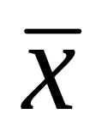

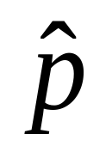

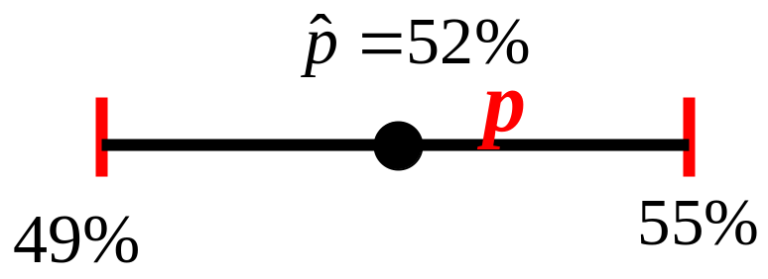
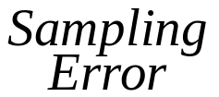
Sampling Error
The Sampling Error is the difference between a sample statistic and its corresponding population parameter.

Slide 6
Margin of Error (ME)
Margin of Error (ME)
ME
The Margin of Error
The Maximum Error
The Maximum Allowable Error
The Maximum Error of the Estimate

Slide 7
Sampling Distribution of the Sample Mean
The Sampling Distribution of Sample Means is a probability distribution consisting of all possible sample means of a given sample size selected from a population.

Slide 8
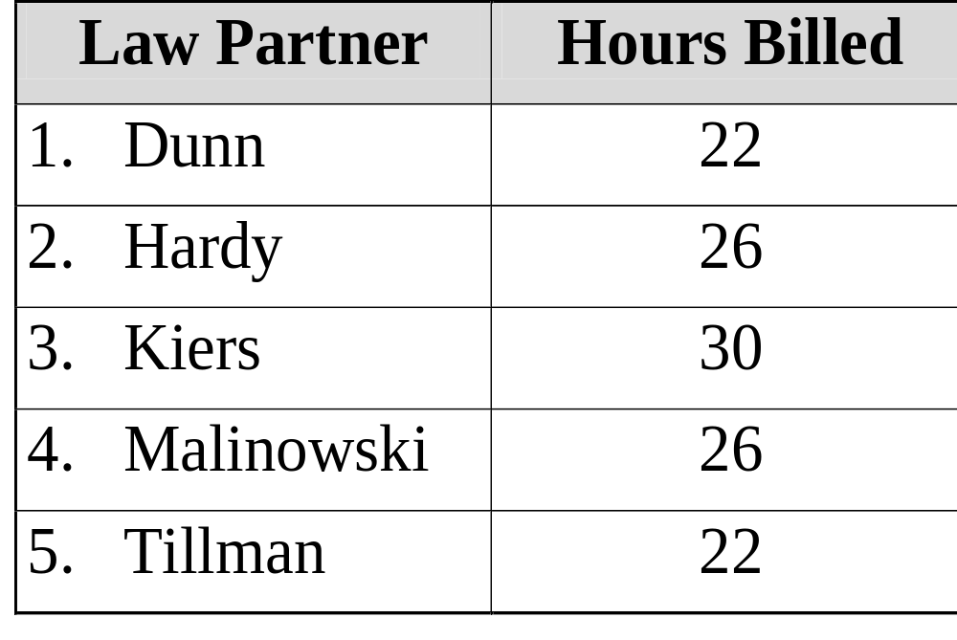
EXAMPLE
A law firm has five partners. At their weekly partners meeting each reported the number of hours they billed clients for their services during the past week.

Slide 9
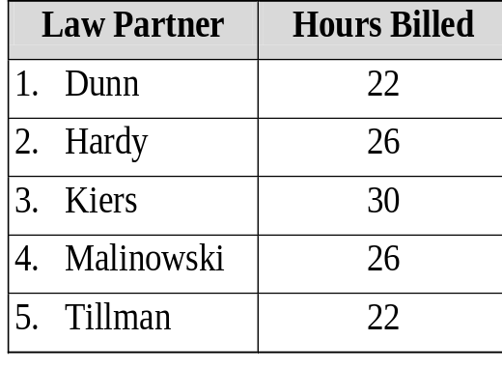
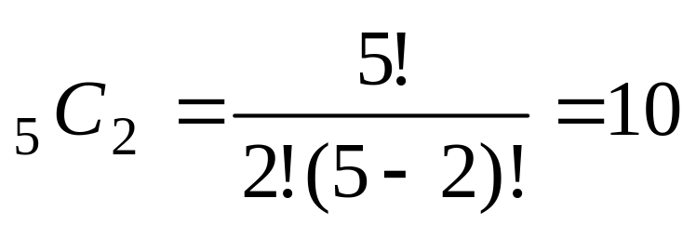
Example continued
If two partners are selected randomly, how many different samples are possible?
There are 10 different samples. This is the combination of 5 objects taken 2 at a time.

Slide 10
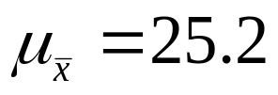

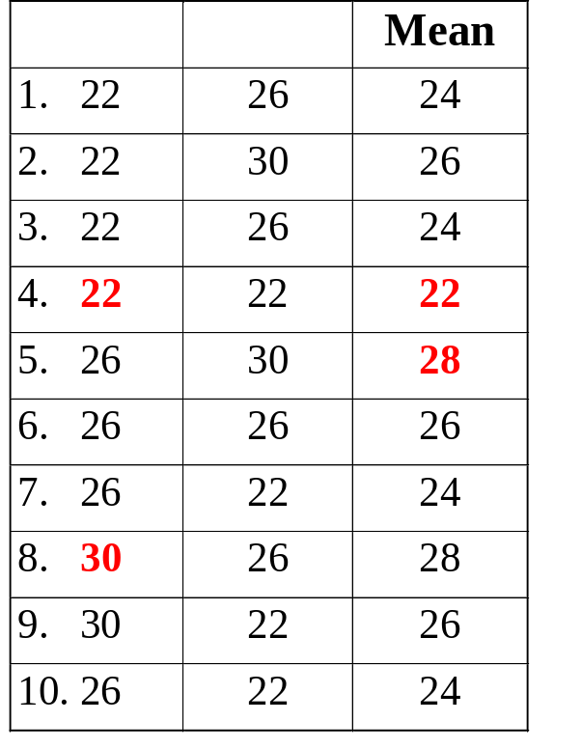
Example continued

Slide 11
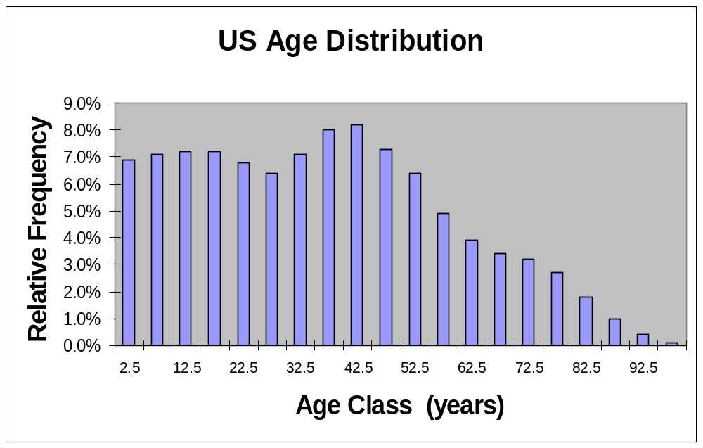
Central Limit Theorem
Even if a population is not normally distributed, its distribution of sampling means will be approximately normal for samples with n ≥ 30. This allows us to use characteristics of the normal curve to answer questions about parameters.

Slide 12
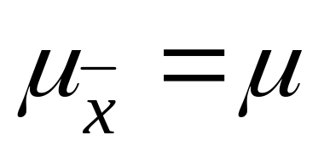
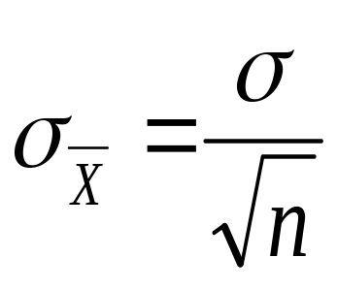

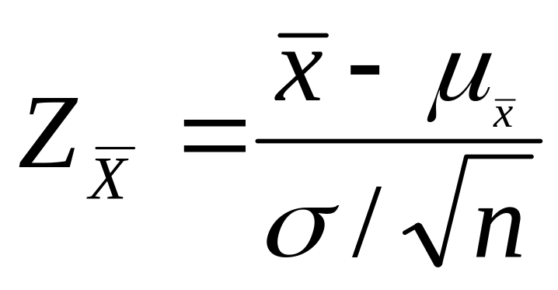
Central Limit Theorem
The mean of all possible sampling means is the true population mean.
Standard Error (SE) of the mean. The standard deviation of the distribution of sampling means. The larger the sample, the less variable the sampling mean. SE will be smaller than the SD of the entire population by a factor of .
Notes:
Example: The average time spent reading a newspaper for the 18 to 24 year old age group is 9 minutes per day with SD=1.5 minutes. What is the probability that the mean time they spend reading is between 8.5 and 9.5 minutes?

Slide 13
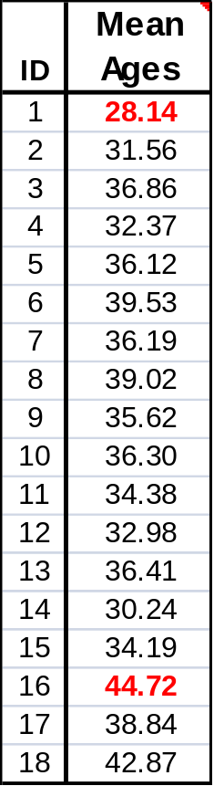
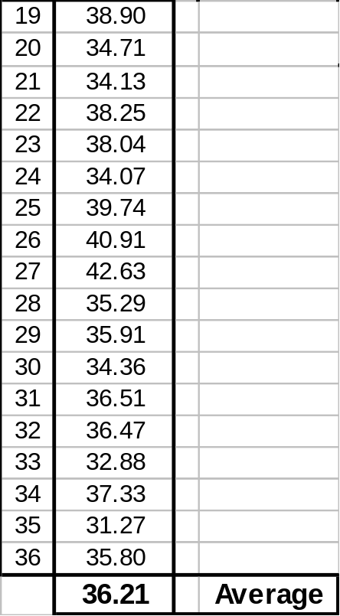
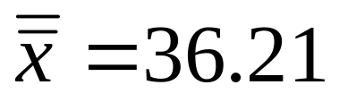
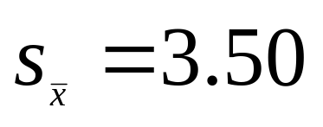
Central Limit Theorem - Example (cont.)
Suppose we hire 36 people across the nation to find the average age of the US population. Each person randomly samples 40 people (n = 40) to determine their ages.
Calculated from mean data.
Range
= 16.6
Notes:
Notice how the range changes from 100 to now just 16.6 for the sample means. This implies that the SD for the sampling means MUST ALSO BE SMALLER.
Also, the 2 means are very close together. 36 samples times 40 people in each sample = 1440 people. ==> Sampling error of +/- 2.6%. The size of the entire population doesn’t matter! All that matter is that you have enough in your sample.

Slide 14
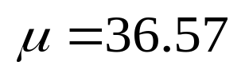

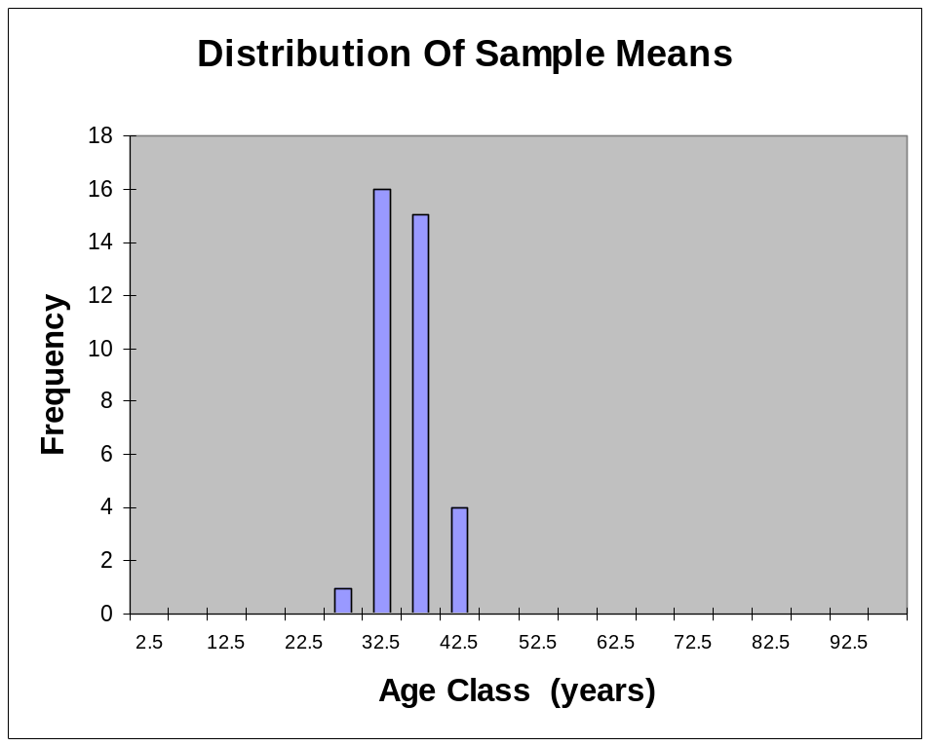


Range =
100.0 Years
Range =
16.6 Years

